Slide 1
End-to-End Training of Deep Visuomotor Policies
Qiang Ma
Feb 19, 2019
Sergey Levine, Chelsea Finn, Trevor Darrell, Pieter Abbeel

Slide 2
Content
Background
Guided Policy Search
Trajectory Optimization
Visuomotor Policy Learning
Experiment

Slide 3
How to do these tasks?
End-to-End Training of Deep Visuomotor Policies, Sergey Levine et al.

Slide 4
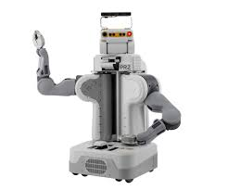
How to do these tasks?
Separately!
Why not put them together?
End-to-End Training of Deep Visuomotor Policies, Sergey Levine et al.
Vision / Perception
e.g. deep neural networks
Object Position
e,g, position of the bottle
Control
Motion Planning

Slide 5
End-to-End Training
End-to-End Training of Deep Visuomotor Policies, Sergey Levine et al.
Learn policies that map raw image observations directly to robot’s motor torques.

Slide 6
How to train the CNN / learn parameter θ
Guided Policy Search
Policy Search
Supervised Learning
End-to-End Training of Deep Visuomotor Policies, Sergey Levine et al.
Video: https://sites.google.com/site/visuomotorpolicy/

Slide 7
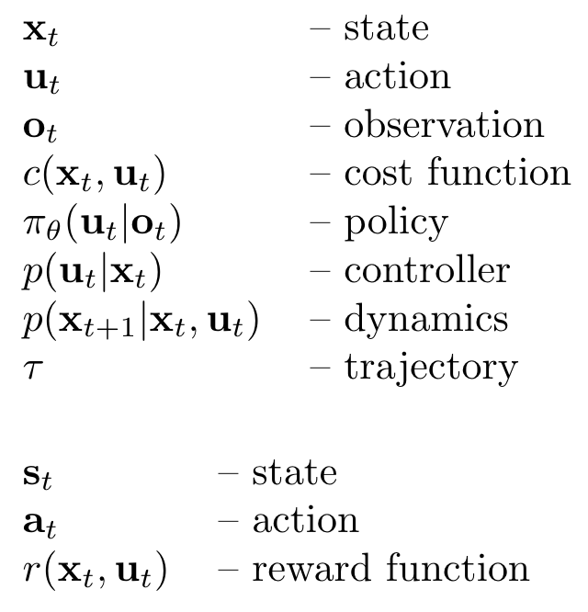
Notations

Slide 8
Guided Policy Search
What is guided policy search?
A model-based reinforcement learning method
[Sergey Levine and Vladlen Koltun. Guided Policy Search. ICLR 2013]

Slide 9
Model-Based RL & Policy Search
Both policy and dynamics/Transition probability are unknown
Need to learn a policy

Slide 10
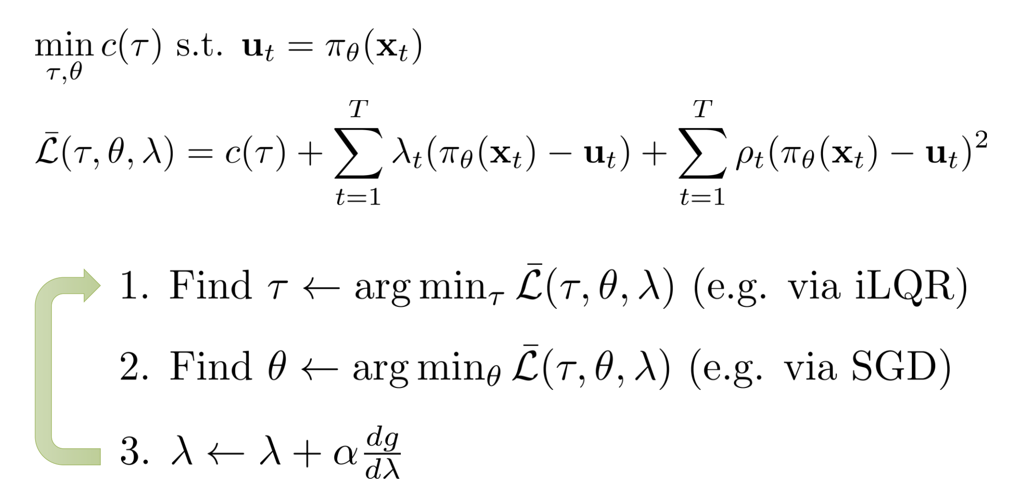
Guided Policy Search (GPS)
From CS 294-112 at UC Berkeley, Sergey Levine et al.
Trajectory guides the policy

Slide 11
Guided Policy Search (GPS)
From CS 294-112 at UC Berkeley, Sergey Levine et al.
augmented Lagrangian
iterative linear quadratic regulator

Slide 12
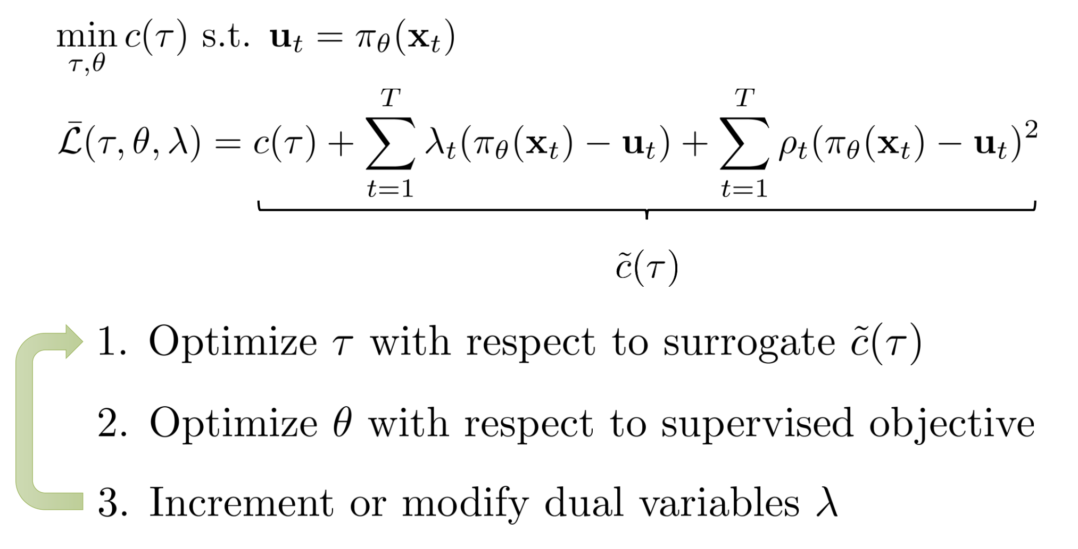
Deterministic GPS
From CS 294-112 at UC Berkeley, Sergey Levine et al.

Slide 13
Deterministic vs Stochastic

Slide 14
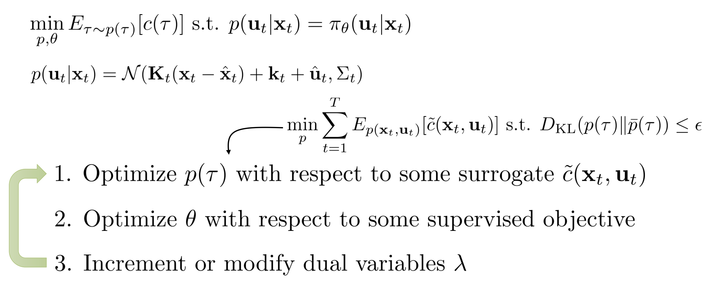
Stochastic GPS
From CS 294-112 at UC Berkeley, Sergey Levine et al.

Slide 15
Stochastic GPS
From CS 294-112 at UC Berkeley, Sergey Levine et al.
“step size”

Slide 16
GPS
?
1. Trajectory Optimization
2. Policy Learning

Slide 17
Trajectory Optimization

Slide 18
Trajectory Optimization

Slide 19
Trajectory Optimization

Slide 20
Trajectory Optimization

Slide 21
Trajectory Optimization

Slide 22
Trajectory Optimization

Slide 23
Stochastic GPS
From CS 294-112 at UC Berkeley, Sergey Levine et al.

Slide 24
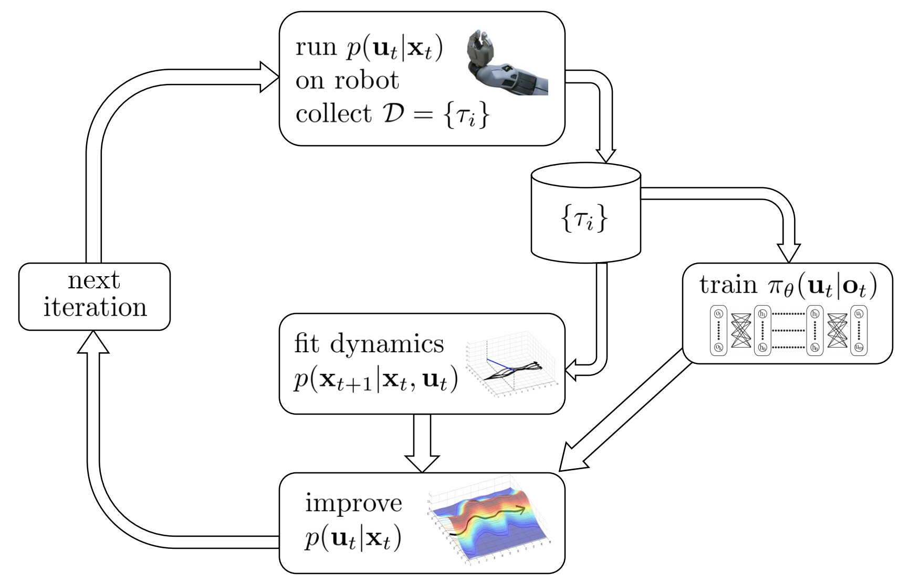
Guided Policy Search
From CS 294-112 at UC Berkeley, Sergey Levine et al.
Trajectory Optimization
Policy Learning

Slide 25
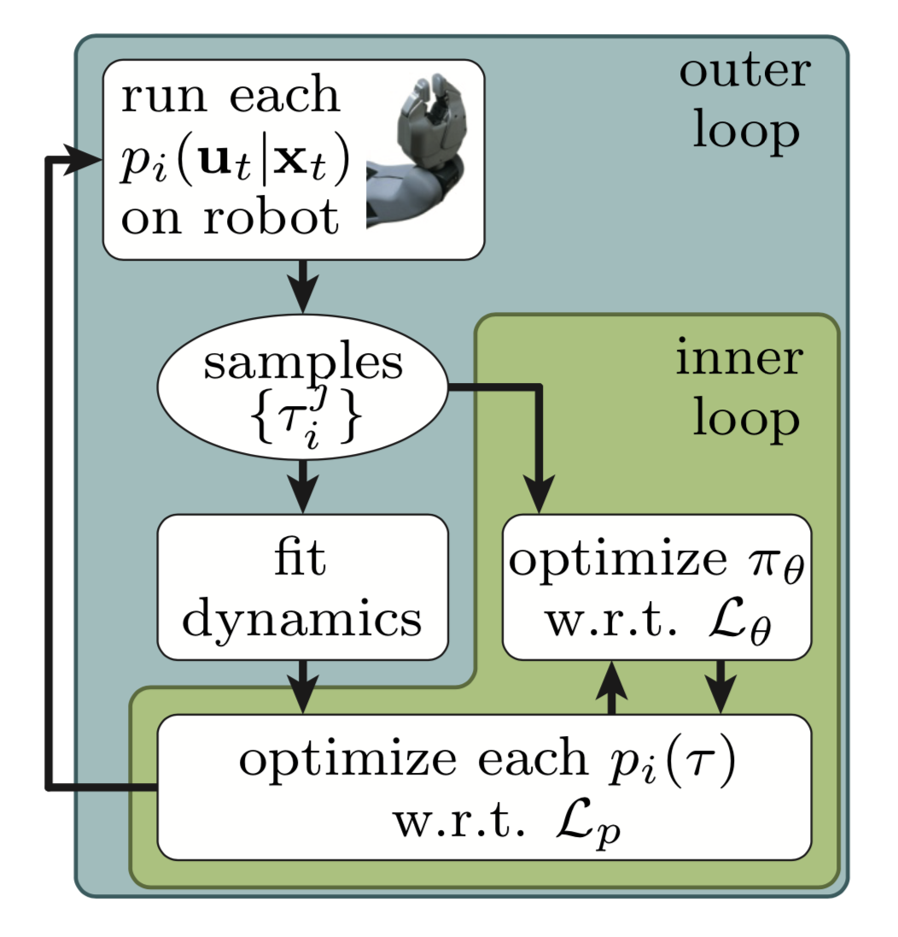
Back to Paper
End-to-End Training of Deep Visuomotor Policies, Sergey Levine et al.

Slide 26
Back to Paper
End-to-End Training of Deep Visuomotor Policies, Sergey Levine et al.

Slide 27
Objective Function
End-to-End Training of Deep Visuomotor Policies, Sergey Levine et al.

Slide 28
BADMM Augmented Lagrangian Method
Objective Function
End-to-End Training of Deep Visuomotor Policies, Sergey Levine et al.
Bregman alternating direction method of multipliers
[H. Wang and A. Banerjee. Bregman alternating direction method of multipliers. NIPS 2014.]

Slide 29
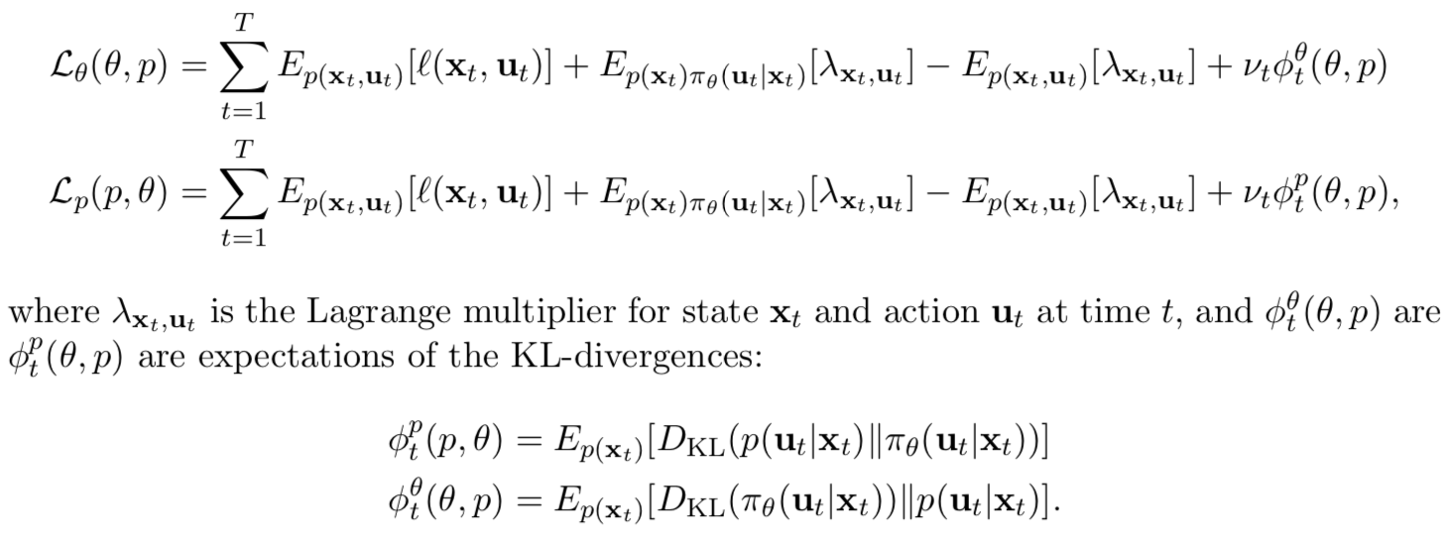
BADMM Augmented Lagrangian Method
End-to-End Training of Deep Visuomotor Policies, Sergey Levine et al.
Bregman divergence

Slide 30
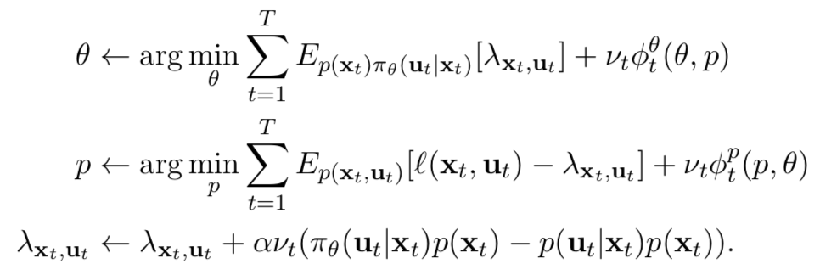
BADMM
End-to-End Training of Deep Visuomotor Policies, Sergey Levine et al.

Slide 31
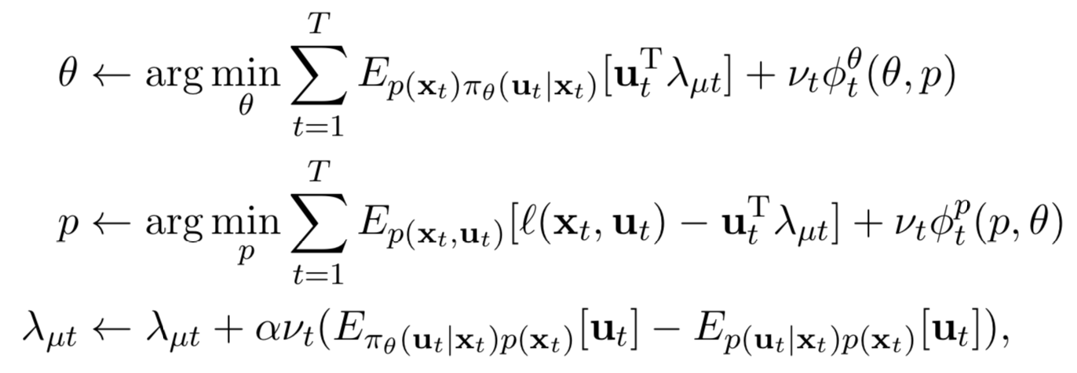
BADMM
End-to-End Training of Deep Visuomotor Policies, Sergey Levine et al.

Slide 32
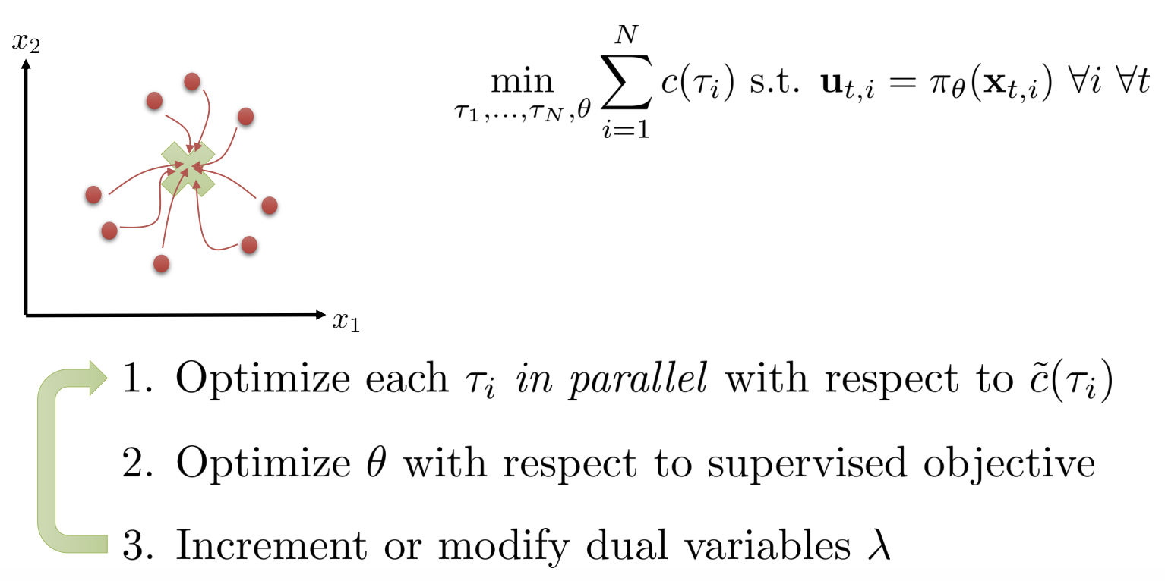
Trajectory Optimization

Slide 33
Trajectory Optimization

Slide 34
Visuomotor Policy Learning
End-to-End Training of Deep Visuomotor Policies, Sergey Levine et al.

Slide 35
Visuomotor Policy Learning
End-to-End Training of Deep Visuomotor Policies, Sergey Levine et al.
Convolutional neural network

Slide 36
CNN Architecture
End-to-End Training of Deep Visuomotor Policies, Sergey Levine et al.
3 convolutional layers
1 spatial softmax layer
3 fully connection layers

Slide 37
Spatial Softmax
End-to-End Training of Deep Visuomotor Policies, Sergey Levine et al.
Spatial softmax
Feature points
32 distributions, 32 feature points, 64 coordinates

Slide 38
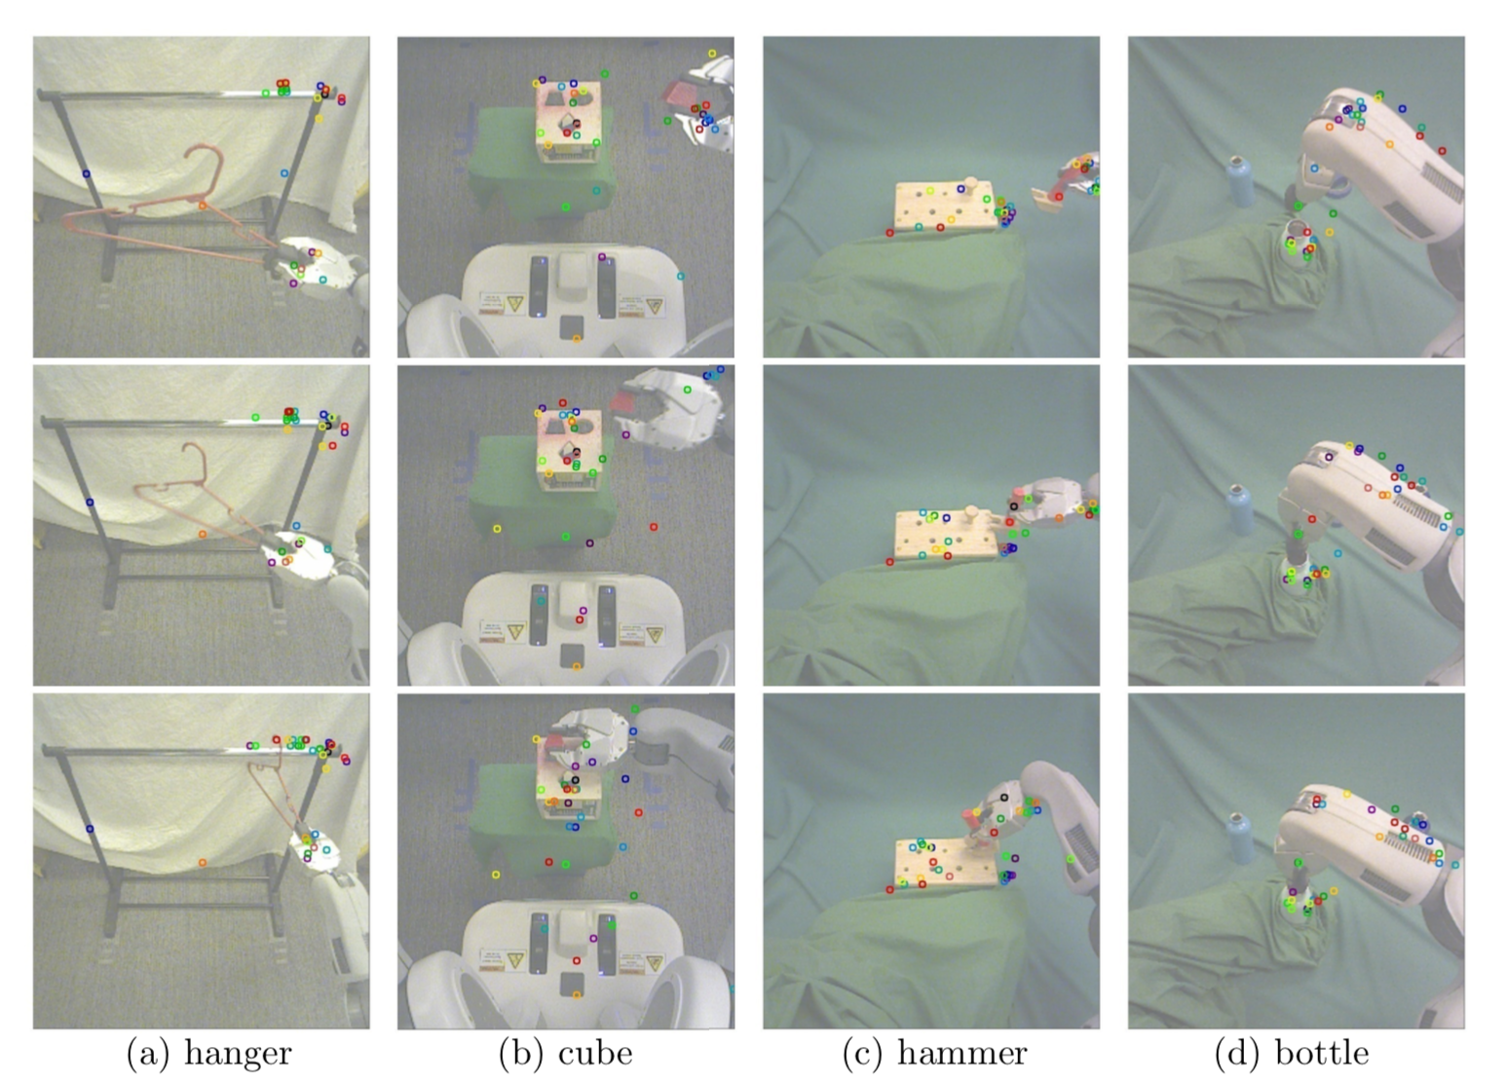
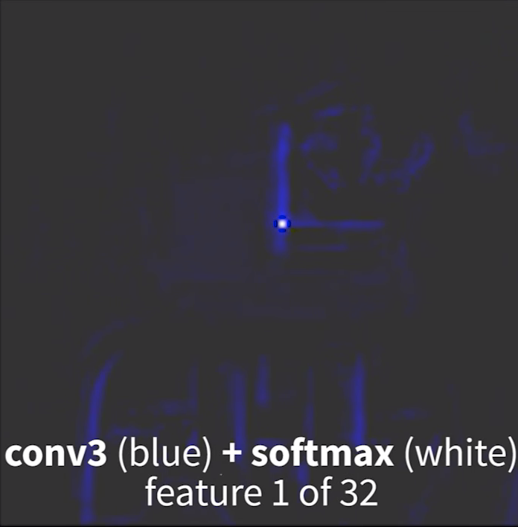
Feature Points
End-to-End Training of Deep Visuomotor Policies, Sergey Levine et al.
Video: https://sites.google.com/site/visuomotorpolicy/

Slide 39
CNN Architecture
End-to-End Training of Deep Visuomotor Policies, Sergey Levine et al.
Robot configuration
includes the angles of the joints, the pose of the end-effector, their velocities
does not include the position of the target object or goal
Motor torques
7 DOF robot arm

Slide 40
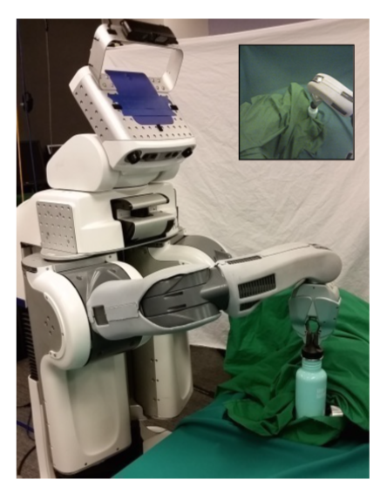
Tricks in Training: Cover left gripper
End-to-End Training of Deep Visuomotor Policies, Sergey Levine et al.
During training, this target object is typically held in the robot’s left gripper.
Therefore, the left arm is covered with cloth to prevent the policy from associating its appearance with the object’s position.

Slide 41
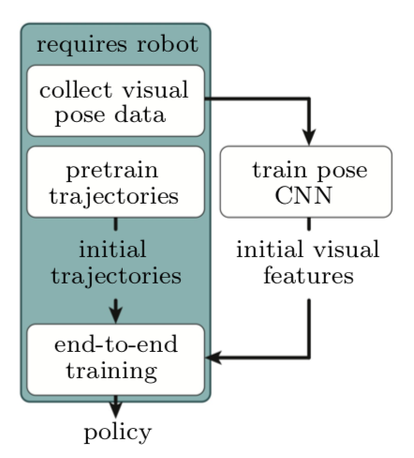
Tricks in Training: Pretrain
End-to-End Training of Deep Visuomotor Policies, Sergey Levine et al.
Train a pose CNN to output the position of target. The pose CNN provides initial weights for policy.
Provide initial trajectories by running guided policy search without optimizing policy
Then end-to-end training

Slide 42
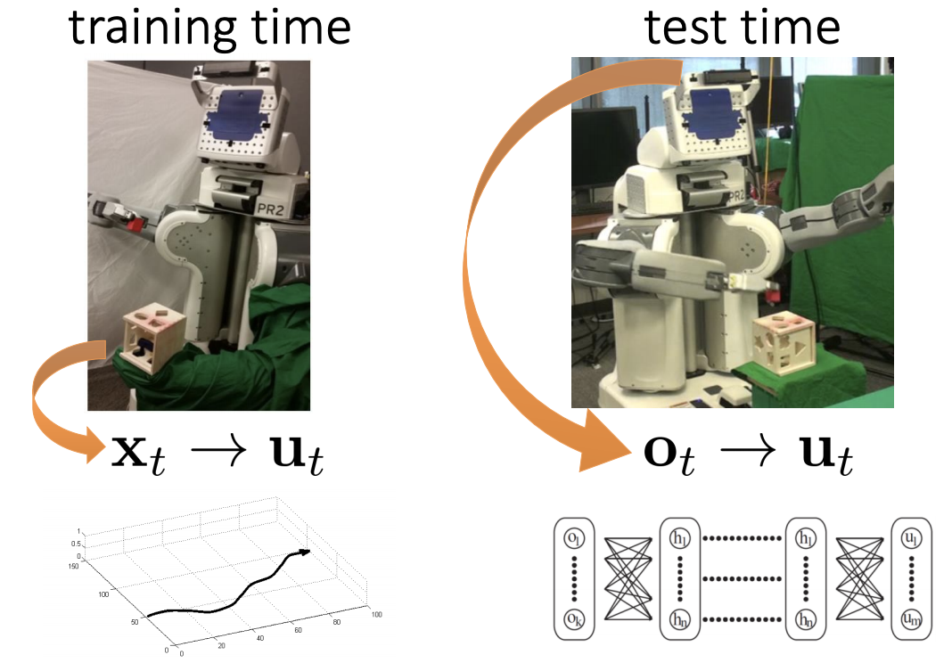
Tricks in Training: Input remapping
End-to-End Training of Deep Visuomotor Policies, Sergey Levine et al.

Slide 43
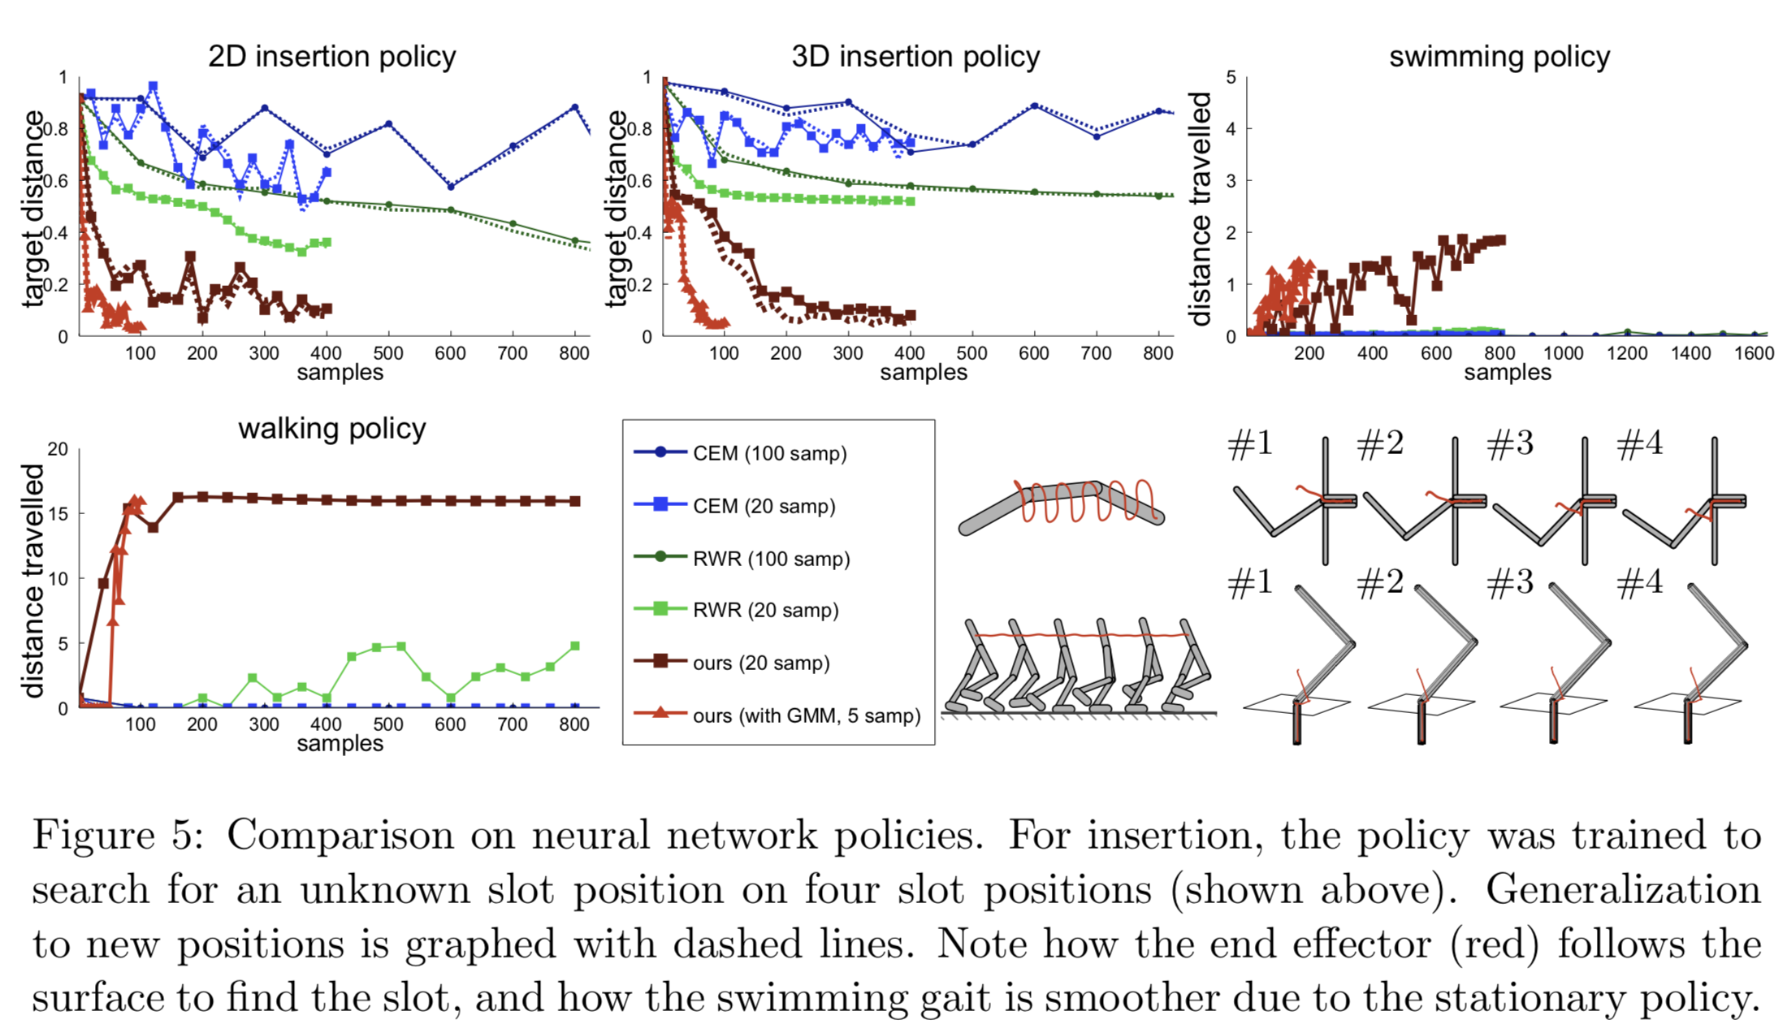
Experiment
Neural Network Policies Comparison

Slide 44
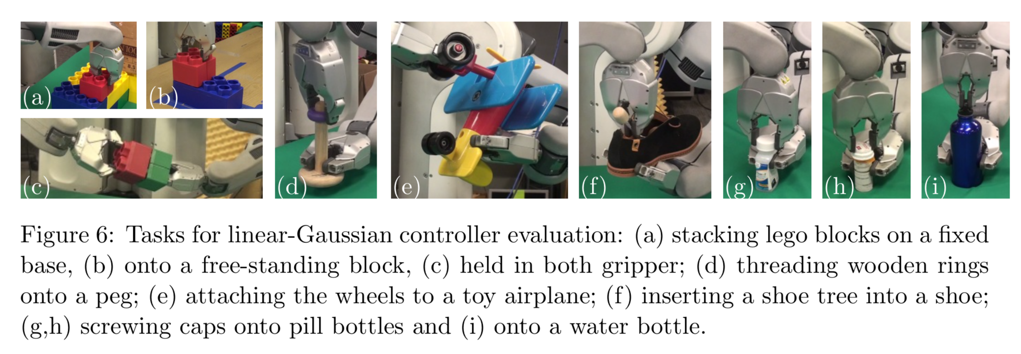
Experiment
Linear-Gaussian controller evaluation

Slide 45
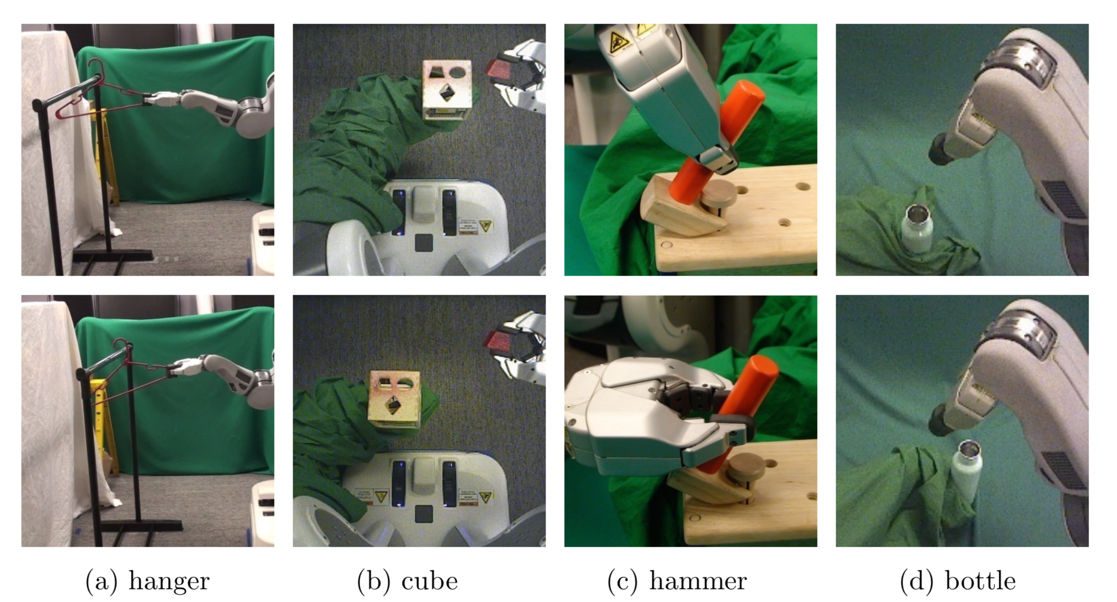
Experiment
Final tasks

Slide 46
Resources
CS 294-112 Deep Reinforcement Learning at UC Berkeley http://rail.eecs.berkeley.edu/deeprlcourse/
Sergey Levine and Vladlen Koltun. Guided Policy Search. ICLR 2013
http://proceedings.mlr.press/v28/levine13.pdf
H. Wang and A. Banerjee. Bregman alternating direction method of multipliers. NIPS 2014
https://arxiv.org/abs/1306.3203

Slide 47
Thank you!
Qiang Ma
Feb 19, 2019

